Slide 1
Psychographics & Demographics

Slide 4
Learn, Practice, Master Loop

Slide 5
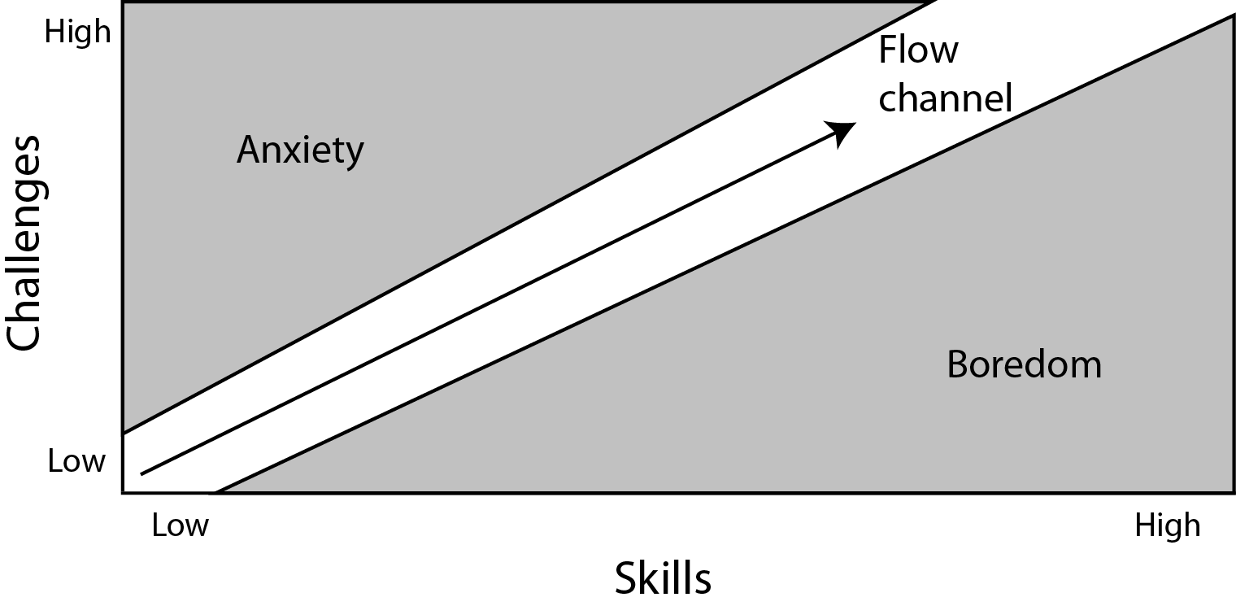
To encourage the player to keep playing this game we need to refer to the Mihaly Csikszentmihalyi (Me-Hi-Cheek-Send-Me-Hi)Flow.

